Slide 1
Discrete Math Lecture 2
Predicate Logic, quantifiers, modular arithmetic and (hopefully) number representations

Slide 2
Quiz

Slide 3
Last week: Propositional Logic and Equivalence Proofs
Only fully True or False statements
No grey area
AND, OR, and NOT operators
Translating English to a more formal, symbolic language
Helped determine the truth of complex statements
Restricted in what kinds of sentences we can translate
Ex. X is divisible by 6

Slide 4
A refresher on the bigger issue here
Prove P V Q is logically equivalent to ¬(P ∧ Q)
Premise
(and assumptions)
Logical steps
Conclusion
We know P and Q are fully True/False statements
No middle ground
BUT they could be any combination of True and False T/T, T/F, F/T, F/F
In simple cases, just show all possible options and explain how they’ll always result in the same outcomes In complex cases, use known information to make our case (also fully true sentences)
Therefore we are right

Slide 5
It’s similar to testing a program
It is not enough to run your code and see it all work
It is not enough to know that you wrote it right
It could all be right but the act of communicating is what others need to trust you
Proofs and Testing are formal ways of communicating

Slide 6
This week: Adding to our vocabulary

Slide 7
Starting with Predicate Logic
aka “first-order logic”
A statement that could be a proposition depending on the values assigned to the variables within
X > 5
If X is 100, this statement is true
Not so much if X = 0
If I am hungry, then I will go get a snack
X owes money to Y
More expressive
This joke is for me – don’t worry about it

Slide 8
Conditional statements
If ______ Then ______
Also sometimes called an “implication”

Slide 9
If I am elected, then I will lower taxes.
P → Q
I must be elected in order for me to lower your taxes
IF P THEN Q
P represents a hypothesis
Aka antecedent or premise
Q is the conclusion
P → Q
P is sometimes called a “hypothesis” or ”premise”
Q is sometimes called a “conclusion” or “consequence”

Slide 10
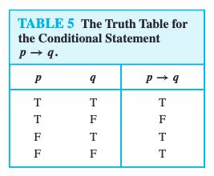
Truth table may not be intuitive
P | Q | P → Q
I am elected | I lower taxes | I did not break my promise
I am elected | I don’t lower taxes | I broke my campaign promise
I am NOT Elected | I lower taxes by calling congress | I did not break my promise
I am NOT Elected | I don’t lower taxes | I did not break my promise
Think of it like a contract. Q can still occur even if P doesn’t happen

Slide 11
Drills
If I said A → B is true which would you KNOW to be true
A must be true
A must be false
A could be either true or false
If I said A → B is false, which would you KNOW to be true
A must be true
A must be false
A could be either true or false
Consider the following statements
If you get a 100% on the final, you’ll get an A
You do not get a 100% on the final
Can you still get an A?
< -- this
< -- this
Yeah!

Slide 12
Translate the following sentences into conditional logic
If I had a world of my own, everything would be nonsense
- Lewis Carroll
You fail if you stop writing
- Ray Bradbury
Whenever people agree with me I feel I must be wrong
- Oscar Wilde
A = I have a world of my own
N = Everything would be nonsense
A → N
Y = You Fail
S = You Stop Writing
S → Y
P = People Agree with me
W = I feel I am wrong
P → W

Slide 13
Combining conditionals with our other statements: Is (P ∧ Q ) → R ≡ P → Q → R
P | Q | (P ∧ Q) | R | (P ∧ Q) → R
T | T | T | T
T | T | T | F
T | F | F | T
T | F | F | F
F | T | F | T
F | T | F | F
F | F | F | T
F | F | F | F
T
F
T
T
T
Hint: remember two statements are logically equivalent if they have identical truth table columns
T
T
T

Slide 14
Combining conditionals with our other statements: Is (P ∧ Q ) → R ≡ P → (Q → R)
Q | R | Q → R | P | P → (Q → R)
T | T |  | T
T | F |  | T
F | T |  | T
F | F |  | T
T | T |  | F
T | F |  | F
F | T |  | F
F | F |  | F
T
F
T
T
T
Hint: remember two statements are logically equivalent if they have identical truth table columns
F
T
T

Slide 15
Combining conditionals with our other statements: Is (P ∧ Q ) → R ≡ P → (Q → R)
P | Q → R | P → (Q → R)
T | T
T | F
T | T
T | T
F | T
F | F
F | T
F | T
T
F
T
T
T
Hint: remember two statements are logically equivalent if they have identical truth table columns
T
T
T

Slide 16
Combining conditionals with our other statements: Is (P ∧ Q ) → R ≡ P → (Q → R)
P | Q | R | (P ∧ Q) → R | P → (Q → R)
T | T | T | T
T | T | F | F
T | F | T | T
T | F | F | T
F | T | T | T
F | T | F | T
F | F | T | T
F | F | F | T
T
T
F
F
T
T
T
T
T
T
Hint: remember two statements are logically equivalent if they have identical truth table columns
T
T
T
T
T
T

Slide 17
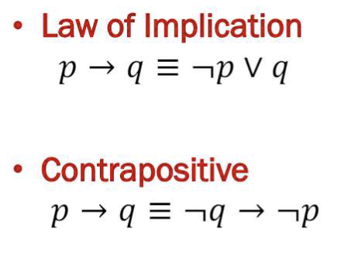
Adding conditionals into Equivalence proofs
Proving (P ∧ Q ) → R ≡ P → (Q → R)
If we had | And used _____ rule to transform | We’d get….
(P ∧ Q ) → R | Law on the left | ¬(P ∧ Q) V R
¬(P ∧ Q) V R | Applying De Morgan’s law | (¬P V ¬Q) V R
(¬P V ¬Q) V R | Applying Associative Law | ¬P V (¬Q V R)
(¬Q V R) | Can be transformed into | Q →R So ¬P V (Q →R)
¬P V (Q →R) | Same transformation here between P and (Q --> R) | P → (Q →R)
These laws don’t get consistent names (as far as I can tell)
There’s more laws for transforming conditionals but we’ll just worry about this one first

Slide 18
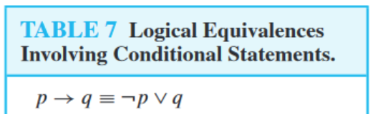
Logical Equivalence: Show that (P ∧ Q ) → P ≡ True
(P ∧ Q ) → P ≡ ¬ (P ∧ Q ) V P
Based on the top equivalence in the chart on the right
At this point, we’re back in Propositional Logic
If we started with…. | And used _____ to transform | We’d get….
¬ (P ∧ Q ) V P
DeMorgan’s Law
(¬ P V ¬ Q ) V P
(¬ P V ¬ Q ) V P
Associative Law
¬ P V ¬ Q V P
¬ P V P V ¬ Q
Complement Law
TRUE V ¬ Q
TRUE V ¬ Q
Annihilator Law
TRUE

Slide 19
P → Q ≡ Q → P?
No
P → Q:
If X is evenly divisible by 8, then it is evenly divisible by 4
P = X is evenly divisible by 8
Q = X is evenly divisible by 4
Q→ P:
If X is evenly divisible by 4, then it is evenly divisible by 8
Reminder
P | Q | P → Q | Q → P
T | T | T | T
T | F | F | T
F | T | T | F
F | F | T | T

Slide 20
Converse, Inverse, and Contrapositive
Given a conditional P → Q
Its converse is Q → P
P and Q are flipped around
Its inverse is ¬P → ¬Q
P and Q are the same, but we have our not operator
Its contrapositive is ¬Q → ¬P
Both flipped AND negated
Conditional: If it rained then the ground is wet
Converse: if the ground is wet, then it rained
Inverse: if it did not rain then the ground is not wet
Contrapositive: if the ground is not wet, then it did not rain

Slide 21
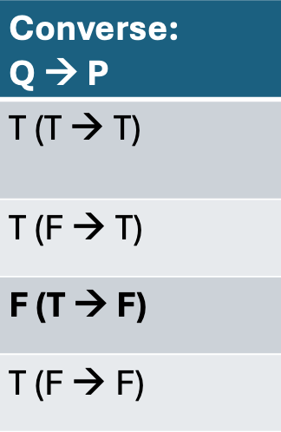
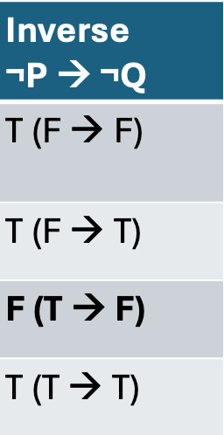
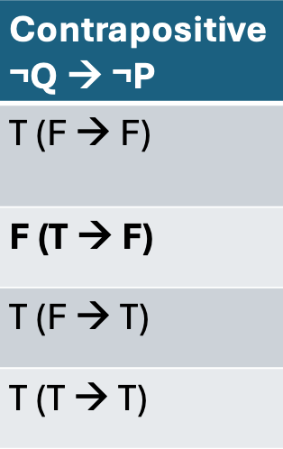
Truth tables
P | Q | Conditional: P → Q | Converse: Q → P | Inverse ¬P → ¬Q | Contrapositive ¬Q → ¬P
T | T | T
T | F | F
F | T | T
F | F | T

Slide 22
Anything logically equivalent?
P | Q | Conditional: P → Q | Converse: Q → P | Inverse ¬P → ¬Q | Contrapositive ¬Q → ¬P
T | T | T | T (T → T) | T (F → F) | T (F → F)
T | F | F | T (F → T) | T (F → T) | F (T → F)
F | T | T | F (T → F) | F (T → F) | T (F → T)
F | F | T | T (F → F) | T (T → T) | T (T → T)

Slide 23
Biconditionals
A double sided arrow is hard to make in powerpoint so my symbols will be inconsistent here – sorry!

Slide 24
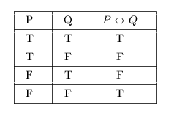
Biconditionals P Q
P is true, if and only if Q
P = “X is an even number”
Q = “X is divisible by 2”
P Q
P is even and Q is divisible by 2
P is even but Q is not divisible by 2
P is odd and Q is divisible by 2
P is odd and Q is not divisible by 2

Slide 25
Conditional and Biconditional practice
Create a truth table for the following statements
¬ ( P → Q)
(P V Q) R
(Q ∧ ¬ P) → R
Translate the following sentences into symbolic logic:
The garbage truck comes down my street if and only if it is Thursday morning

Slide 26
¬ ( P → Q)
P | Q | P → Q | ¬ ( P → Q)
T | T | T | F
T | F | F | T
F | T | T | F
F | F | T | F

Slide 27
P V Q R
P | Q | R | P V Q | P V Q R
T | T | T | T | T
T | T | F | T | F
T | F | T | T | T
T | F | F | T | F
F | T | T | T | T
F | T | F | T | F
F | F | T | F | F
F | F | F | F | T

Slide 28
Q ∧ ¬P → R
P | Q | R | Q ∧ ¬P | Q ∧ ¬P → R
T | T | T | F | T
T | T | F | F | T
T | F | T | F | T
T | F | F | F | T
F | T | T | T | T
F | T | F | T | F Contract broken!
F | F | T | F | T
F | F | F | F | T

Slide 29
The garbage truck comes down my street if and only if it is Thursday morning
“If and only if” is a good signal we’re in for a biconditional
It needs to be Thursday morning for the garbage truck to come
D = It is Thursday Morning
G = The Garbage Truck is coming down my street
D < -- > G
D | G | D <--> T
T | T | T
T | F | F
F | T | F
F | F | T

Slide 30

Order of Operations Practice
First
Which of the following is logically equivalent to ¬P V Q → R
((¬P) V Q) → R
¬(P V Q) → R
Is P V (Q ∧ ¬R) ≡ (P V Q) ∧ ¬R) ?
Last

Slide 31
P | Q | R | ¬P V Q → R (original) | ((¬P) V Q) → R | ¬(P V Q) → R
T | T | T
T | T | F
T | F | T
T | F | F
F | T | T
F | T | F
F | F | T
F | F | F
F V T --> T T
¬(T V T --> T) F
¬(T V T --> T) F
F V T --> F F
¬(T V T --> F) T
¬(T V T --> F) T
F V F --> T T
¬(T V F --> T) F
¬(T V F --> T) F
Most simply: negation happens before V or →
F V F --> F T
¬(T V F --> F) T
¬(T V F --> F) T
T V T --> T T
¬(F V T --> T) F
¬(F V T --> T) F
T V T --> F T
¬(F V T --> F) T
¬(F V T --> F) T
T V F --> T T
¬(F V F --> T) T
¬(F V F --> T) T
T V F --> F F
¬(F V F --> F) F
¬(F V F --> F) F

Slide 32
P V Q ∧ ¬R ≡ (P V Q) ∧ ¬R)
P | Q | R | P V Q ∧ ¬R | (P V Q) ∧ ¬R)
T | T | T
T | T | F
T | F | T
T | F | F
F | T | T
F | T | F
F | F | T
F | F | F
T V T ∧ F T
(T V T) ∧ F) F
T V T ∧ T T
(T V T) ∧ T) T
T V F ∧ F T
(T V F) ∧ F) F
Logical AND has precedence over logical OR If we want an OR evaluated before an AND, we need parens
T V F ∧ T T
(T V F) ∧ T) T
F V T ∧ F F
(F V T) ∧ F) F
F V T ∧ T T
(F V T) ∧ T) T
F V F ∧ F F
(F V F) ∧ F) F
F V F ∧ T
F
(F V F) ∧ T) F

Slide 33
This is a lot
For now, just keep notes on the truth tables for conditionals and biconditionals
Overall:
For simple 2 variable proofs, Truth Table may be easiest
For complex (3 +) variable expressions, Logical equivalence laws may be better

Slide 34
Other types of predicates
Not always in a conditional (if/then) format
X is a prime number
Is a predicate
Truth value depends on what X is
Isn’t a conditional
Different way to express these in math: Propositional Function
P(x) = X is a prime number
P(2) = “2 is a prime number” = True
P(4) = “4 is a prime number” = False

Slide 35
Brief aside to remember high school algebra
In high school: F(x) = x + 4
F(7) = 7 + 4 = 11
F(10) = 14
Short version:
Whatever number replaces our variable replaces it everywhere
Could have many variables
F(x, y, z) = (x + y) / z
F(3, 2, 5) = (3 + 2) / 5 = 1
F(X) = X + 4
X | Y
0 | 4
1 | 5
2 | 6
In algebra: Plotting lines

Slide 36
Expanding our vocabulary in a new way
Translating the following sentence into math: For all natural numbers, that number squared is greater than 0

Slide 37
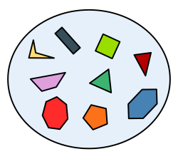
First: Language to talk about groups of things
Or “sets” of things
More on things we can do with sets next week
Today we’ll just identify some
Sets can be groups of anything
Think about when you’ve moved in somewhere new
You may have a box full of stuff related to the kitchen

Slide 38
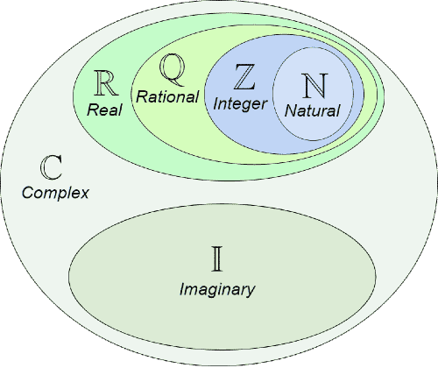
Common sets of numbers

Slide 39
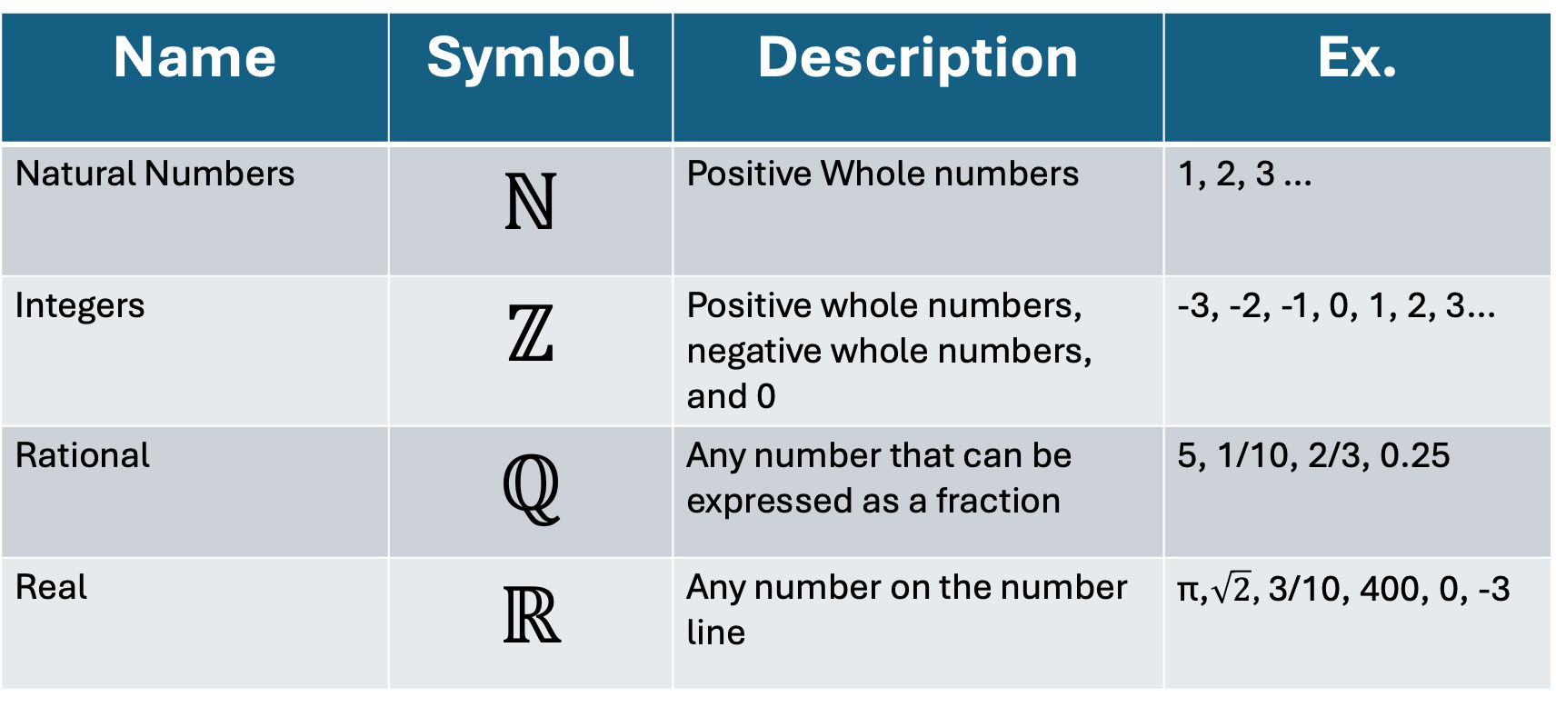
4 to pay attention to right now…
Name | Symbol | Description | Ex.
Natural Numbers | ℕ | Positive Whole numbers | 1, 2, 3 …
Integers | ℤ | Positive whole numbers, negative whole numbers, and 0 | -3, -2, -1, 0, 1, 2, 3…
Rational | ℚ | Any number that can be expressed as a fraction | 5, 1/10, 2/3, 0.25
Real | ℝ | Any number on the number line | π,$\sqrt{2}$, 3/10, 400, 0, -3

Slide 40
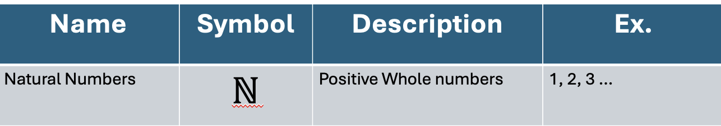
Starting to translate our sentence
For all natural numbers, any number squared is greater than 0
For all numbers in ℕ, any number squared is greater than 0

Slide 41
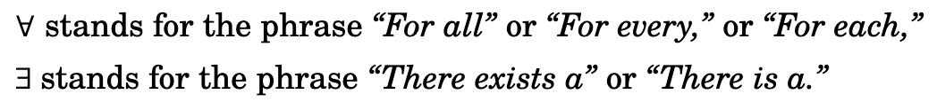
Quantifiers
∈ is our symbol for “within a set”
For all numbers in ℕ, any number squared is greater than 0
∀ x ∈ ℕ, x squared is greater than 0

Slide 42
Back to Propositional Functions
X squared is greater than 0
Expressed as a function: P(x) = x² > 0
∀ x ∈ ℕ, x squared is greater than 0
Full translation:
Let P(x) = x² > 0 ∀ x ∈ ℕ P(x)

Slide 43
One more time
Basic assumption before our statement
Let P(x) = x² > 0 ∀ x ∈ ℕ, P(x)
Strictly speaking we don’t need the function here
∀ x ∈ ℕ, x² > 0 still gets our meaning across
But when our statements get more complex dividing things up will keep things organized
Elements within the set of positive whole numbers
For all

Slide 44
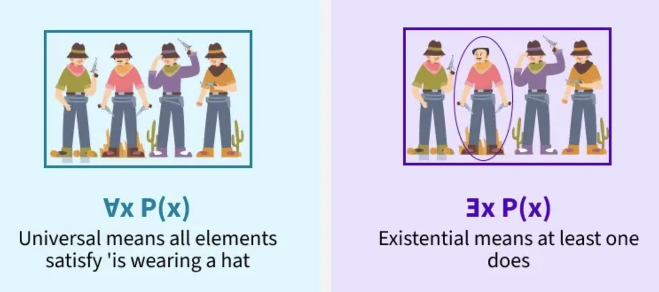
Geeks4Geeks

Slide 45
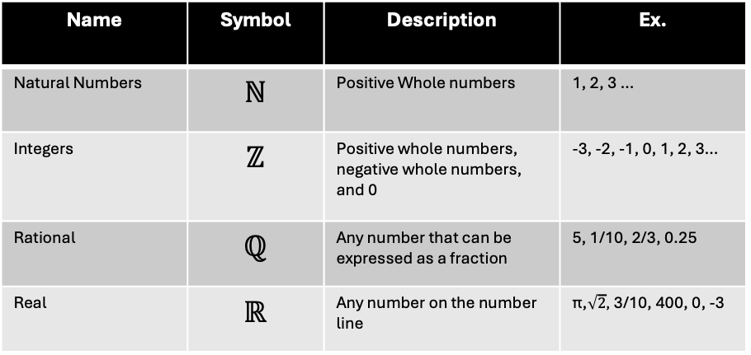
Note, statements with quantifiers don’t have to be True
Together translate
Let E(n) = n is even
∀ n ∈ ℤ, E(n)
∀ = for all
n ∈ ℤ numbers within the set of integers
Overall: “all integers are even”
Name | Symbol | Description | Ex.
Natural Numbers | ℕ | Positive Whole numbers | 1, 2, 3 …
Integers | ℤ | Positive whole numbers, negative whole numbers, and 0 | -3, -2, -1, 0, 1, 2, 3…
Rational | ℚ | Any number that can be expressed as a fraction | 5, 1/10, 2/3, 0.25
Real | ℝ | Any number on the number line | π,$\sqrt{2}$, 3/10, 400, 0, -3
False statement

Slide 46
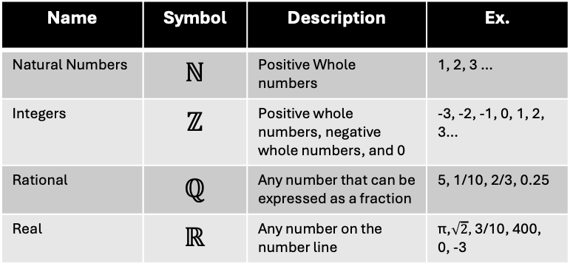

Here’s some more false ones
Name | Symbol | Description | Ex.
Natural Numbers | ℕ | Positive Whole numbers | 1, 2, 3 …
Integers | ℤ | Positive whole numbers, negative whole numbers, and 0 | -3, -2, -1, 0, 1, 2, 3…
Rational | ℚ | Any number that can be expressed as a fraction | 5, 1/10, 2/3, 0.25
Real | ℝ | Any number on the number line | π,$\sqrt{2}$, 3/10, 400, 0, -3
Let P(n) = (n² is equal to 2) ∃ n ∈ ℤ, P(n)
Translated…
S(a, b) = $\sqrt{a ∗ b }$ ∈ ℚ ∀ a, b ∈ Q, S(a, b)
Translated…
There exists an integer for which n² = 2
For any two rational numbers a and b, the square root of their product is also rational

Slide 47
How about a less “math” set
Let L(x, y) = x likes y
Let P be a set of all people (past, present, and future)
Translate the following into symbolic logic
Everyone likes everyone
Someone does not like anyone
Everyone likes George
There is no one whom everyone likes
∀ x, y ∈ P, L(x,y)
∃ x ∈ P ∀ y ∈ P ¬ L(x,y)
∀ x ∈ P, L(x, George)
¬ ∃ x ∈ P, ∀ y ∈ P, L(x, y)

Slide 48

More practice
Symbolic | English
Let P(x) = (x² < x) ∃ a ∈ ℚ, P(a)
 | There exists an odd integer
Let B(x) = x has a book Let S be a set of all students at the Roux ∀ x ∈ S, B(x)
 | There are two integers, X and Y, that are are even
There is a rational number that gets smaller when squared
Let P(n) = n is odd ∃ n ∈ ℤ, P(n)
All students have a book
Let G(x) = x is even ∃ x, y ∈ ℤ, (G(x) V G(y))
Name | Symbol | Description | Ex.
Natural Numbers | ℕ | Positive Whole numbers | 1, 2, 3 …
Integers | ℤ | Positive whole numbers, negative whole numbers, and 0 | -3, -2, -1, 0, 1, 2, 3…
Rational | ℚ | Any number that can be expressed as a fraction | 5, 1/10, 2/3, 0.25
Real | ℝ | Any number on the number line | π,$\sqrt{2}$, 3/10, 400, 0, -3
∀ is “for all”, ”for every”, or “for each” ∃ is “there exists” or “there is” ∈ is our symbol for “within a set”

Slide 49
Putting it all together
Every integer that is not odd is even
∀
x ∈ ℤ
P(x) = x is odd
¬P(x)

Slide 50
Putting it all together
Every integer that is not odd is even
Let P(x) = x is odd
∀
x ∈ ℤ,
¬P(x) → P(X)
For all integers, if a number X is not odd, then it is even

Slide 51
More practice together Given any two rational numbers a and b, the product a*b is rational.
Any = ∀
2 variables that are in the set of rational numbers = a,b ∈ ℚ
Let P(a,b) = (a * b) ∈ ℚ
a * b is within the set of rational numbers is a proposition
∀ a, b ∈ ℚ, P(a,b)

Slide 52
Mixed quantifiers
Order of quantifiers matter!
For all real numbers X, there exists a real number Y such that X + Y = 4
Let P(x,y) = 4
∀x∈ℝ, ∃y ∈ℝ , P(x,y)
Is that the same as saying: ∃ x∈ℝ, ∀y ∈ℝ , P(x,y)
For any electronic device in my house I can find a charger for it…somewhere
There exists a charger in my house that can work with ALL electronic devices in my house
There exists x ∈ R such that for all y ∈ R, x + y = 4
There exists 1 number such that it can be added to ANY number and you’ll get 4

Slide 53
Translation
Check to see if a sentence can be phrased as a conditional
Look for keywords like every, any, or there exists
Create functions to represent any propositions
Try translating back to make sure your English and math are logically equivalent
Keep in mind that our brains can correct English to get the meaning
All students do not come to campus for class
Really means
Not all students come to campus for class

Slide 54
If time, more practice:
Let A is a set of numbers (with at least 2 elements in it)
Let P(x) be some proposition
Translate the following:
∃x∈A, P(x) → ∀y∈A, P(y)
If there exists an item in A with some property, then all items in A have that property

Slide 55
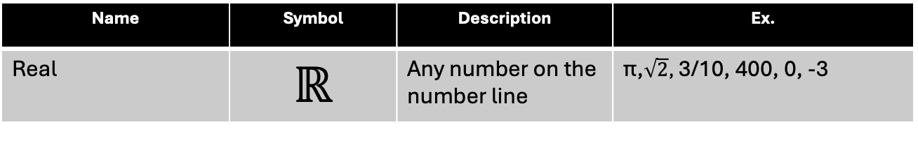
Ok so what do we do with all of this
Prove or disprove ∀ x ∈ ℝ, x² > 0
What does this mean in English?
Let's think through some examples
Integer (no decimal) Ex. 400 or -3
Rational (can be a fraction) Ex. ½ or -1/3
Irrational (can’t be a fraction) Ex. Pi
Can be 0
400² is positive, -3² is positive
Both of those examples squared are positive
Pi is positive so whatever it is squared is positive
0² Is….still 0
Name | Symbol | Description | Ex.
Real | ℝ | Any number on the number line | π,$\sqrt{2}$, 3/10, 400, 0, -3

Slide 56
The simple ones to prove
To disprove a ∀
Find 1 counter example
To prove ∃
Find one example
Given some propositional function Q(x)
∀ x ∈ N , Q(x) is logically equivalent to saying ∀ (x ∈ N ) ⇒ Q(x) is True

Slide 57
So long as x is a legal thing for us to be talking about (aka in N) Then Q(x) will hold
X is in the set N | Q(x) is True | (x ∈ N ) → Q(x)
T | T | T
T | F | F
F | T | T
F | F | T

Slide 58
Harder…
To prove a ∀
To disprove ∃
Either way, we can’t just find 1
We need to show how it works for EVERYTHING in the set we’re talking about

Slide 59

What about proving the following: Let A be some set of numbers Let P and Q be some propositional functions Prove ∀x∈A, (P(x)∧Q(x))→P(x)
Premise
(and assumptions)
Logical steps
Conclusion

Slide 60
Let A be some set of numbers Let P and Q be some propositional functions Prove ∀x∈A, (P(x)∧Q(x))→P(x)
For number x that is in A, P(x) will either be a true or false statement. Same for Q
That’s how predicates work
Therefore, we can create 2 propositional statements
A = P(x) is True
B = Q(x) is True
Thus, this can be translated as A ∧ B → A

Slide 61
Let A be some set of numbers Let P and Q be some propositional functions Prove ∀x∈A, (P(x)∧Q(x))→P(x)
For number x that is in A, P(x) will either be a true or false statement. Same for Q
That’s how predicates work
Therefore, we can create 2 propositional statements
W = P(x) is True
Z = Q(x) is True
Thus, this can be translated as W ∧ Z → W
That all elements of A fit the above statement…
We need to prove W ∧ Z → W is a tautology (always true)

Slide 62
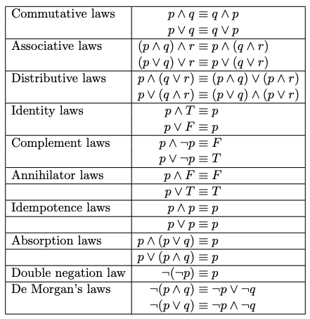
Prove A ∧ B → W is a tautology
W ∧ Z → W ≡ ¬(W ∧ Z ) V W
¬(W ∧ Z ) V W ≡ ¬W V ¬ Z V W
¬W V W is always True
True or anything is always True
W | Z | W ∧ Z → W
T | T | T → T = T
T | F | F → T = T
F | T | F → F = T
F | F | F → F = T

Slide 63
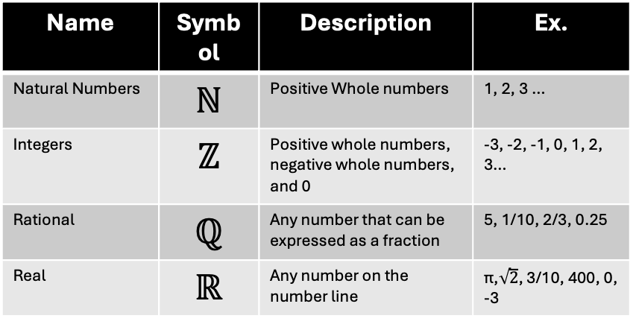
If time, a few final practice problems
Number 1
Let A be a set of 3 numbers (aka A = {2, 3, 4})
Let P(x) = x > 0
Prove that ∀x∈A, P(x)
(don’t overthink this one)
Number 2
Disprove the following…
Let P(x,y) = x < y ∀x∈ ℕ ∃ y x∈ ℕ, P(x)
Number 3
Let S be a set of all integers EXCEPT for 0 Prove that if you squared any number in S, that number would be positive (aka >0) Hint: there are some external properties of how we multiply numbers that will help here
Name | Symbol | Description | Ex.
Natural Numbers | ℕ | Positive Whole numbers | 1, 2, 3 …
Integers | ℤ | Positive whole numbers, negative whole numbers, and 0 | -3, -2, -1, 0, 1, 2, 3…
Rational | ℚ | Any number that can be expressed as a fraction | 5, 1/10, 2/3, 0.25
Real | ℝ | Any number on the number line | π,$\sqrt{2}$, 3/10, 400, 0, -3

Slide 64
Number 1
Let A be a set of 3 numbers (aka A = {2, 3, 4})
Let P(x) = x > 0
Prove that ∀x∈A, P(x)
Simple enough to do without much formal logic
2 > 0
3 > 0
4 > 0

Slide 65
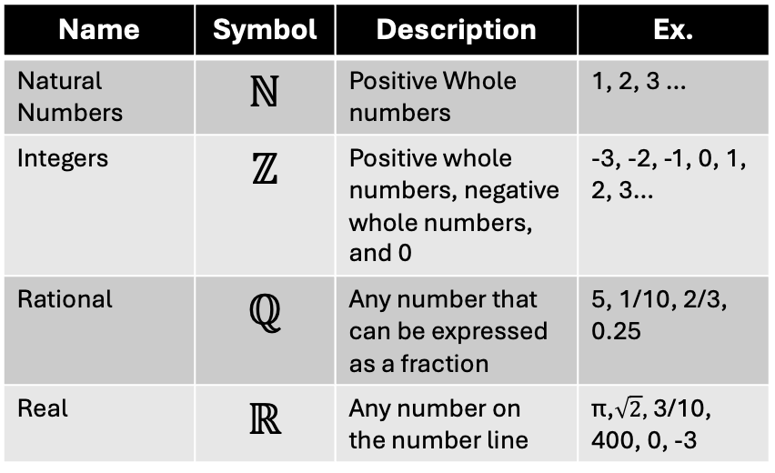
Number 2: Disprove
Name | Symbol | Description | Ex.
Natural Numbers | ℕ | Positive Whole numbers | 1, 2, 3 …
Integers | ℤ | Positive whole numbers, negative whole numbers, and 0 | -3, -2, -1, 0, 1, 2, 3…
Rational | ℚ | Any number that can be expressed as a fraction | 5, 1/10, 2/3, 0.25
Real | ℝ | Any number on the number line | π,$\sqrt{2}$, 3/10, 400, 0, -3
Let P(x,y) = x < y ∀x∈ ℕ ∃ y x∈ ℕ, P(x)
Smallest natural number is 1
So let's say x = 1
We can’t go SMALLER so let's say y is also 1
P(1, 1) is false because x isn’t smaller than y
Therefore the whole statement is disproven

Slide 66
Number 3
Let S be a set of all integers EXCEPT for 0 Prove that if you squared any number in S, that number would be greater than 0
Integers are, by definition: positive whole numbers, negative whole numbers, and 0.
S is all positive whole numbers and negative whole numbers but not 0
let's assume we have some random negative whole number N
A negative number times a negative number is always positive
Let's then assume we have some random Positive number
A positive number times a positive number is always positive
Therefore, since we only have positive and negative numbers, ∀x∈S, x² > 0

